Slide 1


OBIstat:
Ontological Representation of Biostatistics Terms
Yongqun “Oliver” He, Marcy Harris
University of Michigan
Ann Arbor, MI 48109, USA

Slide 2
Ontological Representation of Statistical Analyses
OntoDM:
Ontological representation of data mining tasks and complex data types.
http://kt.ijs.si/panovp/doku.php?id=ontodm
HELO: Hypothesis and Law Ontology
https://github.com/larisa-soldatova/HELO
Both with specific focuses and align with IAO
Other related ontologies?

Slide 3
OBIstat: An OBI Subset and Extension with a focus on statistics
OBI is large and has many focuses
Goal: Develop an OBI subset with a specific focus on statistics
Strategy: two methods:
Obtaining existing statistics terms in OBI: using OntoFox MIREOT method
Generating new statistics terms (which are expected to be vetted and become part of OBI later
Note: OBIstat includes both parts

Slide 4
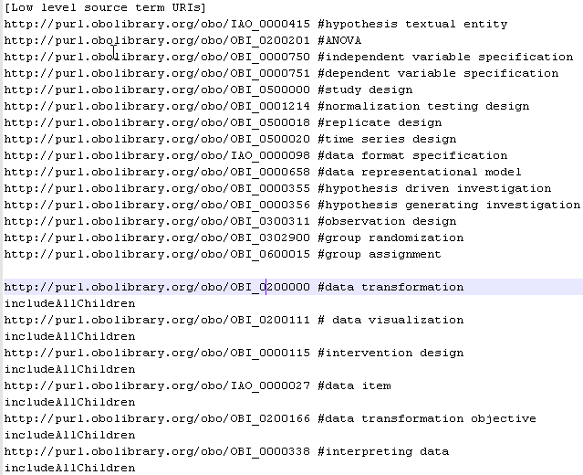
Fetching OBI statistics subset using OntoFox
OntoFox input: defining OBI terms to fetch:
Many OBI branches are fully taken

Slide 5
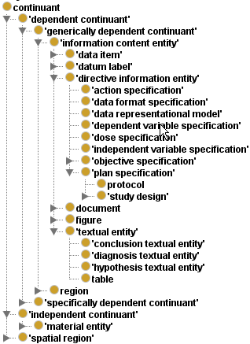
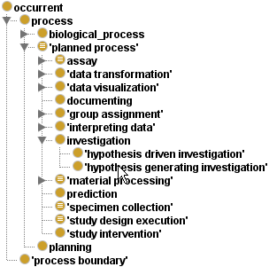

Results: The OBI subset focusing on Biostatistics
Get all branch terms:
data transformation
data visualization
intervention design
data item
data transformation objective
intepreting data
Maintain inferring capability

Slide 6
Generating New Statistics Terms
Defined an Excel worksheet template for representing new statistics terms
Specified 118 new statistics terms using the template
URL: http://obi.svn.sourceforge.net/viewvc/obi/trunk/docs/presentations/OBI%20workshop%20May%202012%20Ann%20Arbor/OBI%20Statistics/OBIstat%20source/OBIStat_new_terms_IDs-v2.xlsx?revision=3745
Ontorat tool (http://ontorat.hegroup.org) was used to convert the Excel results to OWL file
Refined the results in Protégé-OWL editor

Slide 7
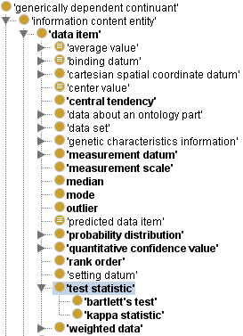
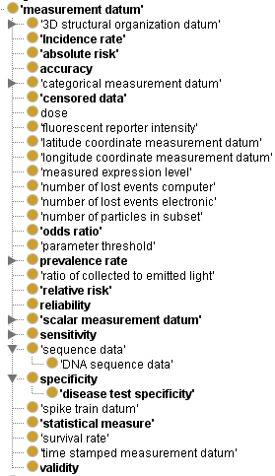
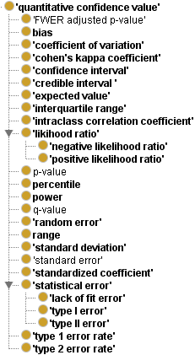
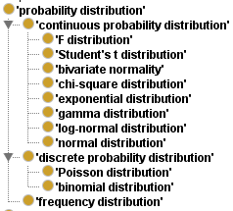
Added many terms under OBI “data item”
Can add more test statistics later

Slide 8
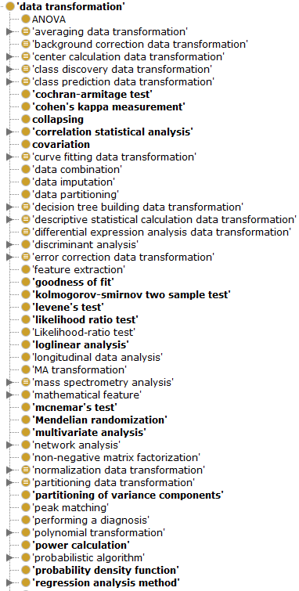
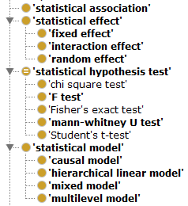
Added many terms under OBI “data transformation
Jessica: which should be under ‘statistical hypothesis test’?

Slide 9
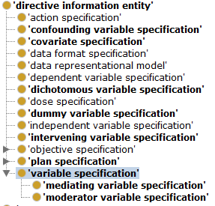
New term “variable specification”
Def: “a directive information entity that specifies a statistical variable whose value may change within the scope of a given problem or set of operations”
May move several variables to under this term, including:
Independent variable specification
Dependent variable specfication
Notes:
Look for other ontologies for such term definitions.

Slide 10
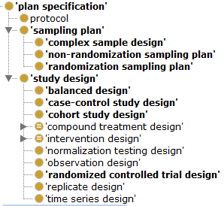
May move “sampling plan” under ‘study design’
Study design Def: “A study design is a plan specification comprised of protocols (which may specify how and what kinds of data will be gathered) that are executed as part of an investigation and is realized during a study design execution.”
Sampling plan def: “a plan specification that provides a detailed outline of which measurements will be taken at what times, on which material, in what manner, and by whom.”
Notes:
Look for other ontologies for such term definitions.

Slide 11
OBI Biostatistics Subset Design Pattern
Study design
part_of?
hypothesis textual entity
is_about
data item
(e.g., p-value)
has_specified_output
has_
specified
_input
hypothesis driven investigation
data item
(input data set)
data transformation
achieves_
planned_objective
has_specified_input
data visualization
data transformation objective
What about a specific statistics test?
Notes:
realizes some (concretizes some ‘study design')

Slide 12
What a specific statistical method does?
A specific statistical test like t-test has the following components:
The test label, e.g., student’s t-test
Test statistic
Mathematic model
Test distribution, e.g., , student’s t distribution
Test result value, e.g., p-value
Hypothesis
We want to represent each of these

Slide 13
Challenges
How to represent mathematic formula using ontology?
How to represent statistical null hypothesis?
How to run ontology-supported statistical analysis within the context of semantic web?

Slide 14
Acknowledgements
OBI, IAO
Philippe Rocca-Serra, Alfred Hero,
Jessica Turner,
all in 2012 OBI face-2-face
Ann Arbor workshop
NIH-NIAID Grant: R01AI081062

